Slide 1
2022/10/21 Meeting
B10907034 王信舜

Slide 2
Model Structure

Slide 3
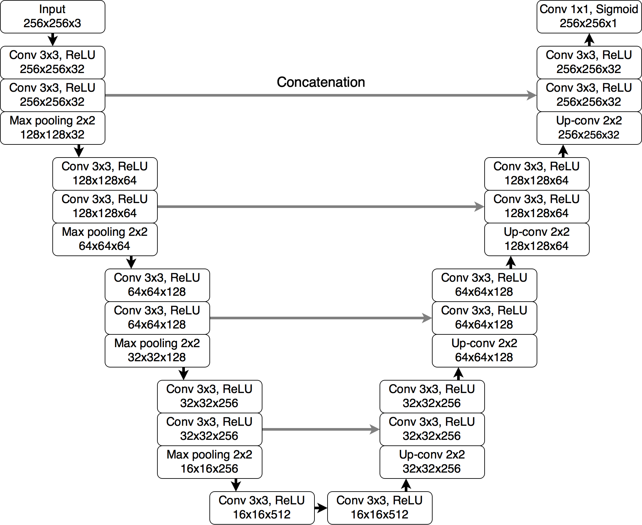
Pytorch U-NET for Brain MRI Example
Ref: https://pytorch.org/hub/mateuszbuda_brain-segmentation-pytorch_unet/

Slide 4
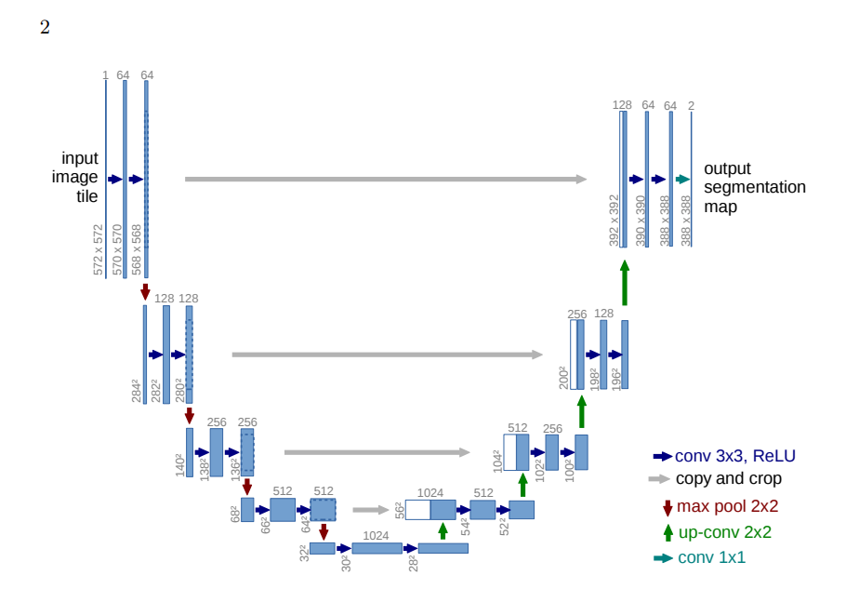
My U-NET from paper ^{[1]}

Slide 5
Performance Test
Condiction:
Learning Rate = 1e-2
Batch Size = 1
Number of Epochs = 20

Slide 6
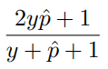

Evaluate Metrics
Average Head Dice Coefficient:
Head Dice Coefficient =
Average Head Dice Coefficient = $\frac{Head Dice Coef}{Number of Heads}$

Slide 7
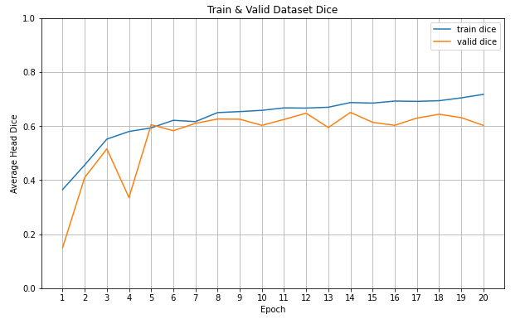
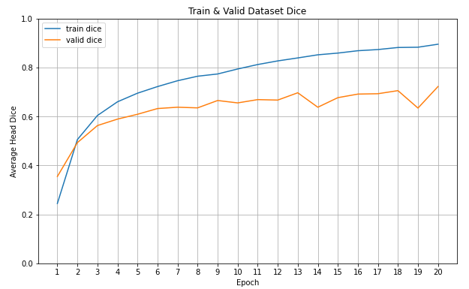
Test Result (PyTorch UNET Example)
Adam
SGD

Slide 8
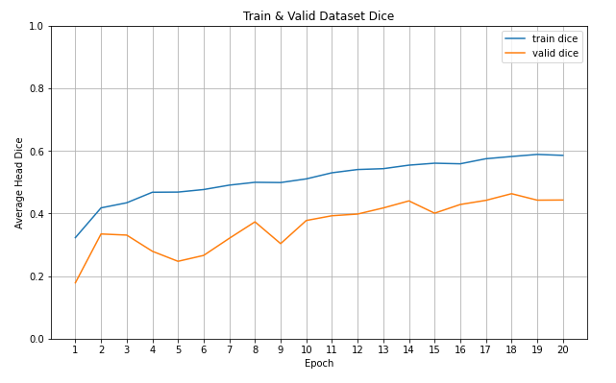
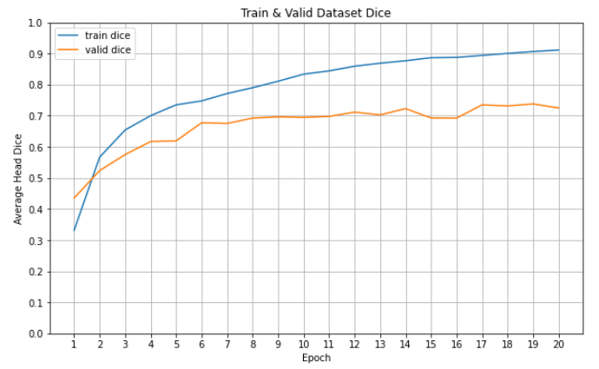
Test Result (UNET from Paper)
Adam
SGD

Slide 9
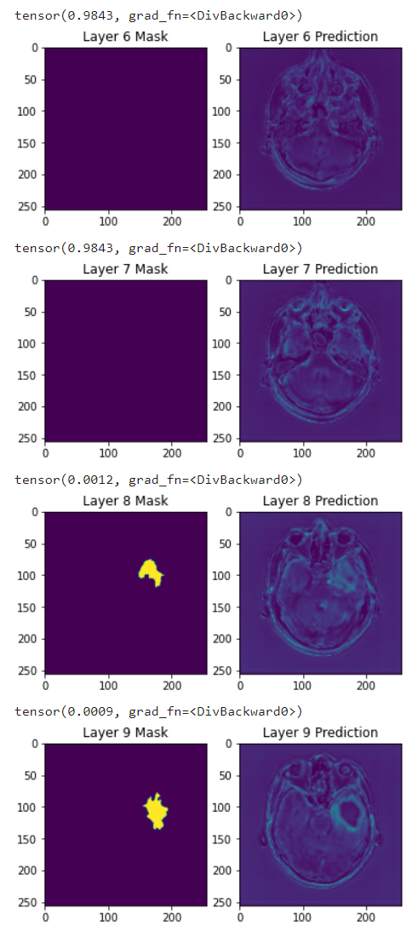
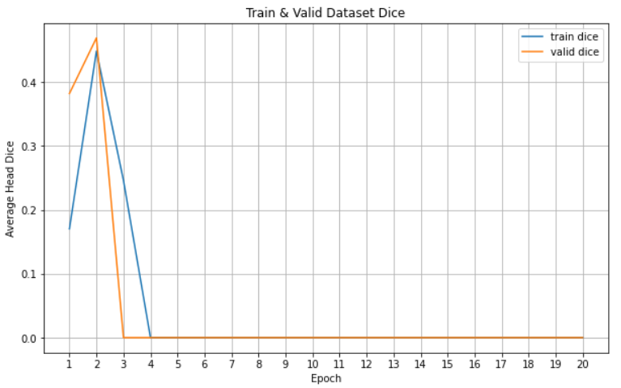
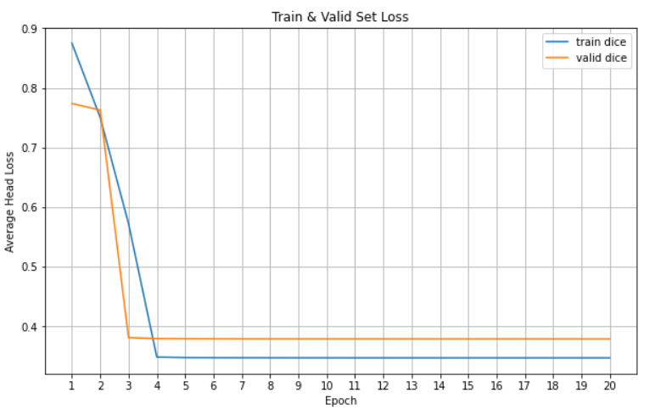
TorchUNET, DICE LOSS, Batch Size = 1
Testset Model Output
Average Head Dice
Single 2D Slice Dice Loss

Slide 10
Assumption
Data Imbalance.
Dice Loss’s gradient isn’t good on False Negative.
Batch Size too small causes model stuck at local minimum.
Attempt
Try Tversky Loss, Focal Tversky Loss. ^{[2]}
Increase Batch Size.
Optimizer Adam (have momentum).

Slide 11
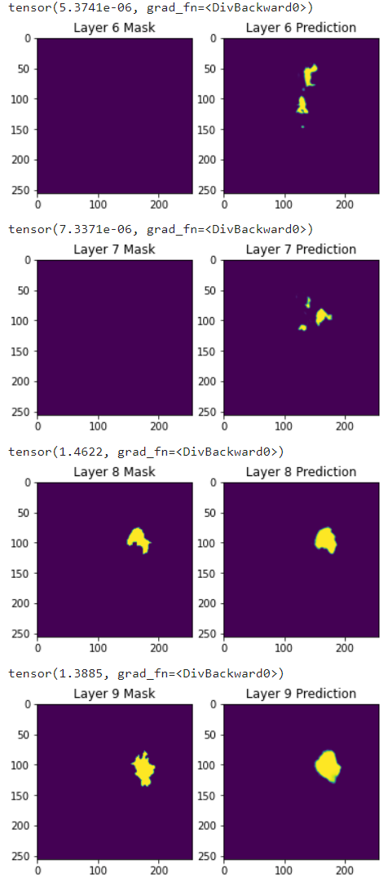
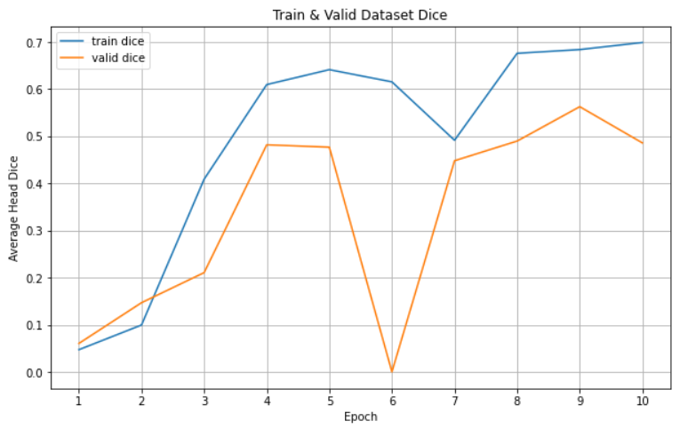
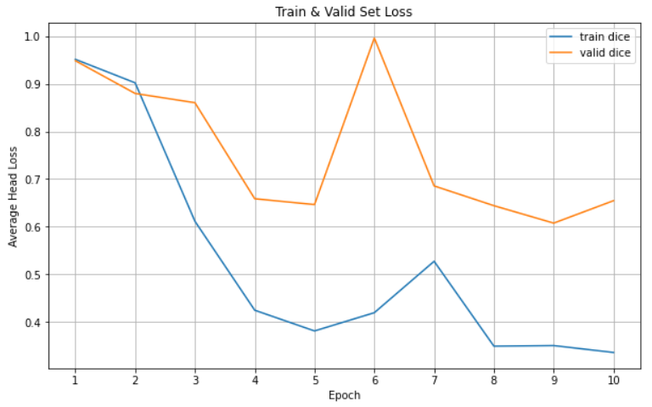
My UNET, Dice Loss, Batch Size = 10
Testset Model Output
Average Head Dice
Single 2D Slice Dice Loss

Slide 12
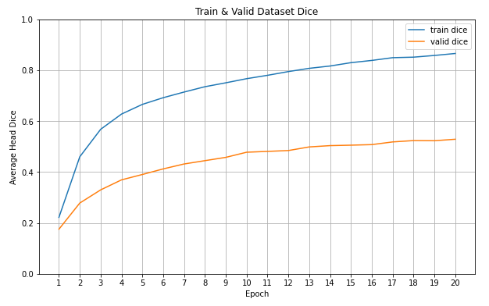
Test Dice: 0.57131

Slide 13
References
[1] Olaf Ronneberger, Philipp Fischer, and Thomas Brox, U-Net: Convolutional Networks for Biomedical Image Segmentation https://arxiv.org/abs/1505.04597
[2] Shruti Jadon, A survey of loss functions for semantic segmentation https://arxiv.org/abs/2006.14822?fbclid=IwAR3ehmNzw0UKELox-ippD4gA-YGs0XRK1m5uUVxivcphJ2rnJKgafSTXH7U

Slide 14
2022/11/11 Meeting
B10907034 王信舜

Slide 15
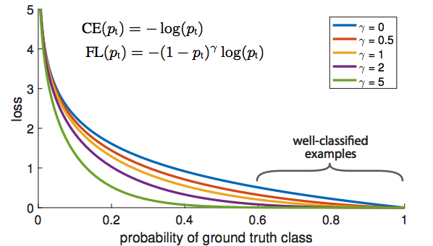
Focal Loss
Gradient of hard example
Gradient of Easy example

Slide 16
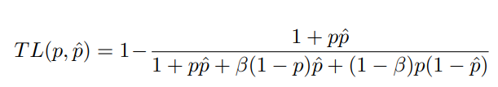
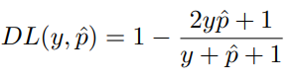
Tversky Loss
Dice Loss

Slide 17
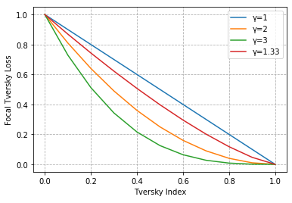
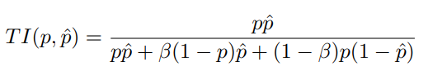
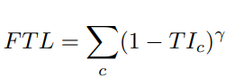
Focal Tversky Loss

Slide 18
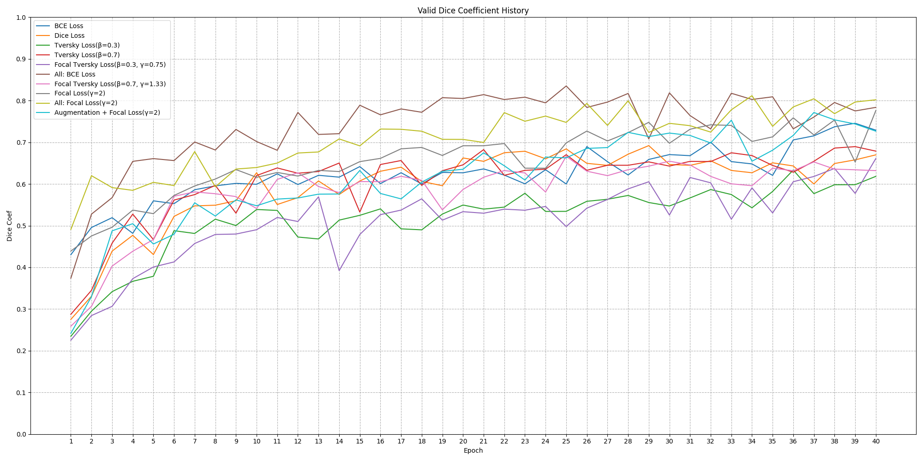

Slide 19
LR= 1e-4 | Loss Functions | Evaluation Metrics
 |  | Dice Coefficient | Sensitivity | Specificity | Fpr | Fnr | PPV | NPV
Tumor Data Only | BCE Loss 1 | 0.765 | 0.914 | 0.997 | 0.002 | 0.086 | 0.610 | 0.998
 | Focal Loss (gamma=2) 8 | 0.835 | 0.942 | 0.998 | 0.002 | 0.058 | 0.703 | 0.999
 | Tversky Loss (beta=0.3) 3 | 0.652 | 0.948 | 0.993 | 0.007 | 0.052 | 0.352 | 0.999
 | Tversky Loss (beta=0.7) 4 | 0.731 | 0.912 | 0.997 | 0.003 | 0.088 | 0.479 | 0.998
 | Dice Loss 2 | 0.721 | 0.920 | 0.996 | 0.004 | 0.080 | 0.494 | 0.998
 | Focal Tversky Loss (beta=0.3, gamma=0.75) 5 | 0.723 | 0.914 | 0.996 | 0.004 | 0.086 | 0.535 | 0.998
 | Focal Tversky Loss (beta=0.7, gamma=1.33) 7 | 0.684 | 0.926 | 0.995 | 0.005 | 0.074 | 0.396 | 0.998
All Data | BCE Loss 6 | 0.782 | 0.853 | 0.999 | 0.001 | 0.147 | 0.945 | 0.997
 | Focal Loss (gamma=2) 9 | 0.792 | 0.898 | 0.998 | 0.002 | 0.102 | 0.925 | 0.998

Slide 20
Data Augmentation
Original Train Set
Length = L
Train Set
Length = 2L
Augmentation
Augmented Train Set
Length = L

Slide 21
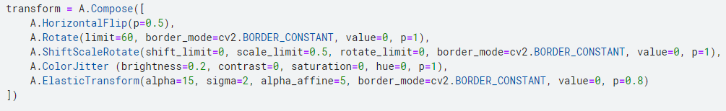
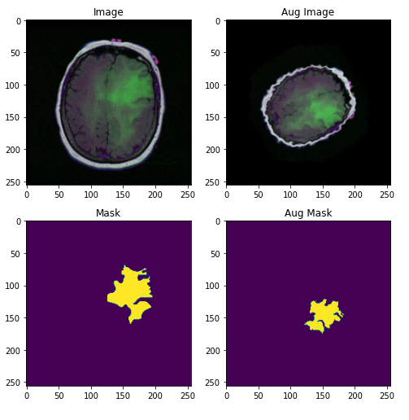
水平翻轉 (機率: 0.5)
整張圖片旋轉 (±60度, 機率: 1)
縮放 (±0.5倍, 機率: 1)
像素亮度變化 (±0.2, 機率: 1)
Elastic Transform (機率: 0.8)

Slide 22
Adam, lr=1e-4, epochs=40
LR= 1e-4 | Loss Functions | Evaluation Metrics
 |  | Dice Coefficient | Sensitivity | Specificity | Fpr | Fnr | PPV | NPV
Tumor Data Only, Augmentation | Focal Loss | 0.722 | 0.937 | 0.996 | 0.004 | 0.063 | 0.414 | 0.999

Slide 23
2022/12/02 Meeting
B10907034 王信舜

Slide 24
Try 1
Num of epochs = 50
Learning rate = 1e-4
Batch size = 1
Loss function: Focal Loss(gamma=2)
Training Set: 剩下的
Validation Set: Patient ID 71~140
Test Set: Patient ID 1~70

Slide 25
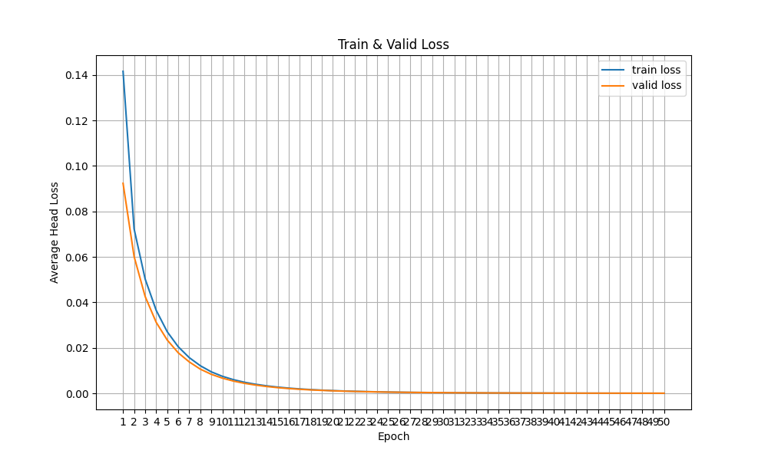
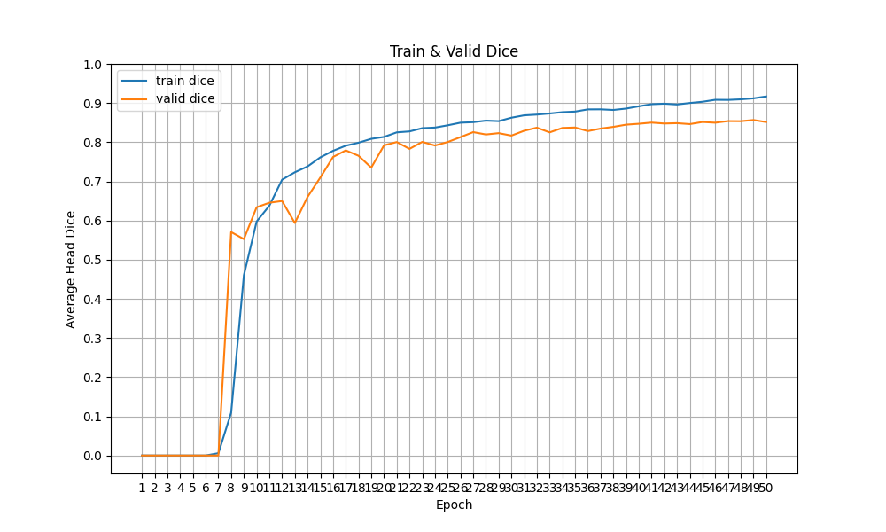
Try 1

Slide 26
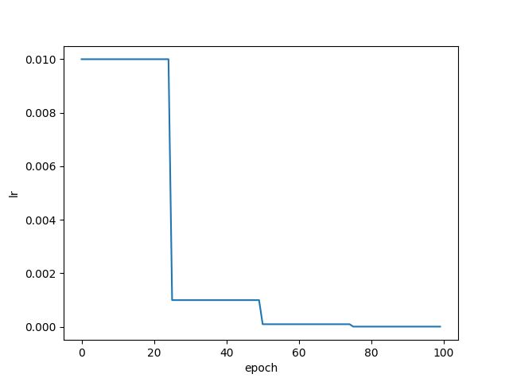
Try 2
Num of epochs= 100
Step LR decay: 起始lr=0.01, 每25epoch下降原本之為0.1倍
Training Set: 剩下的Data
Validation Set: Patient ID 1~70

Slide 27
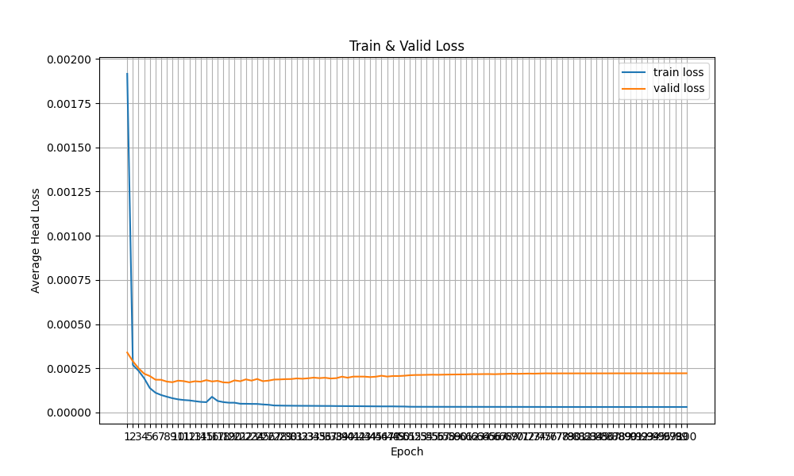
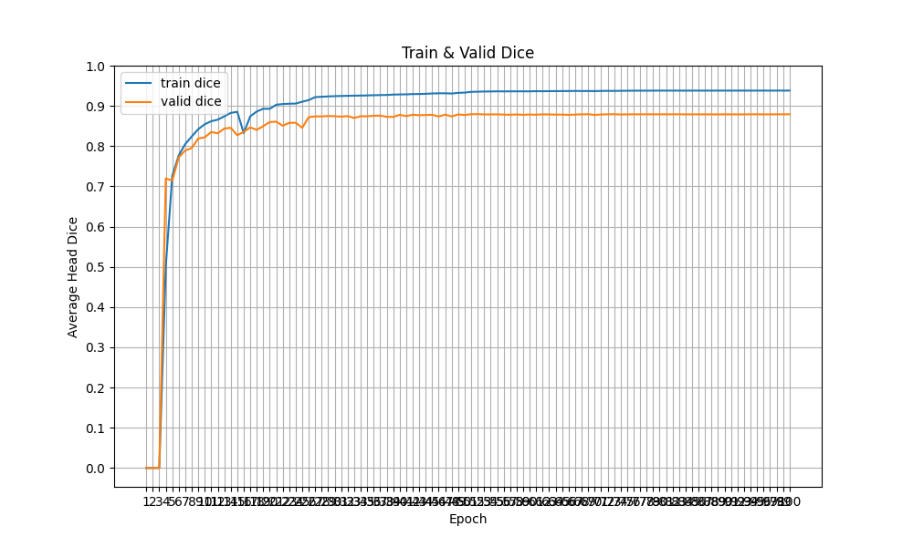
Try 2

Slide 28
Result
Try | Dice
1 | 0.827
2 | 0.879

Slide 29
2023/01/06 Meeting
B10907034 王信舜

Slide 30
Dice 比較
Model | Unet: 24 channels, trained in Dim=128 With StepLR saved in original size | Tigerbx 1.8
Dice Score | 0.753 | 0.798

Slide 31
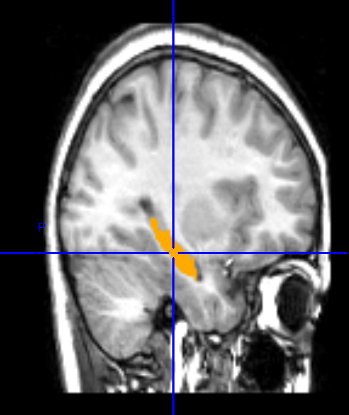
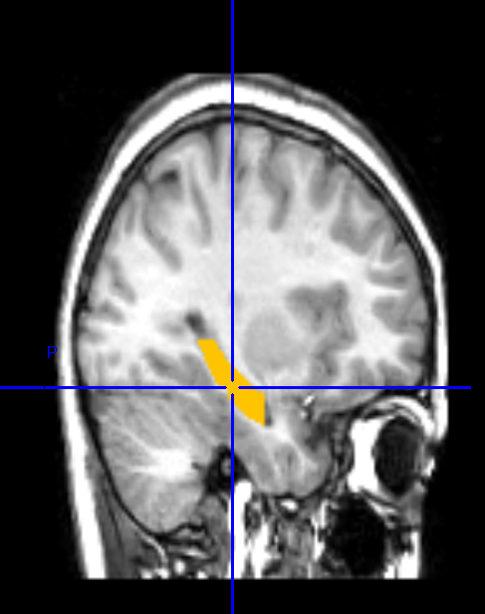
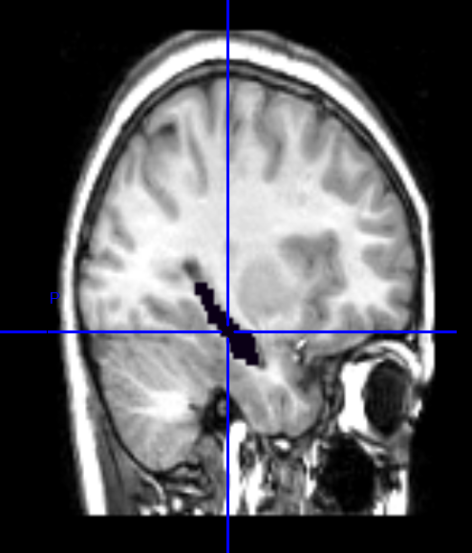
Candi123 label
tigerbx
My Unet

Slide 32
2023/02/24 Meeting
B10907034 王信舜

Slide 33
Generative Model

Slide 34
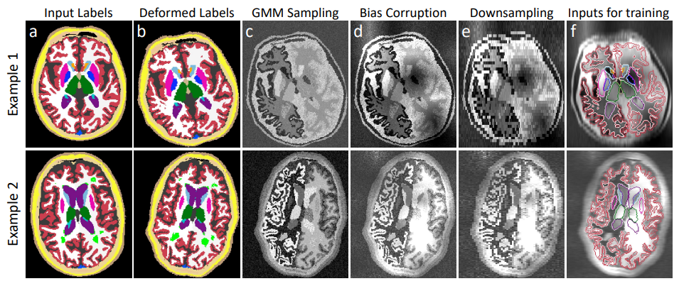

Slide 35
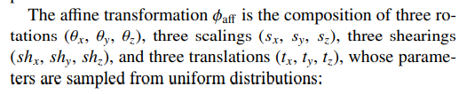
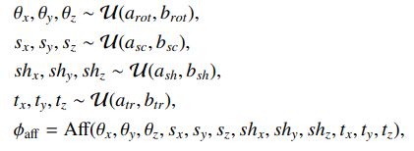
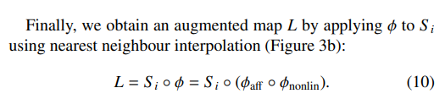
Linear Transform

Slide 36
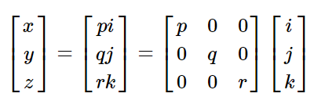
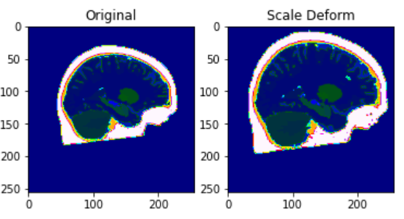
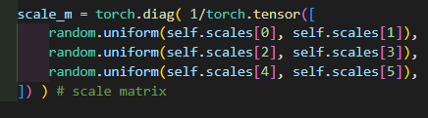
Scaling

Slide 37
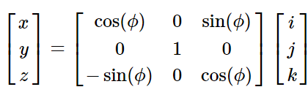
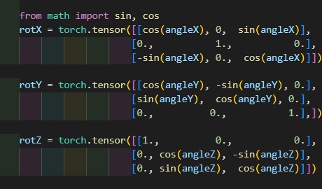
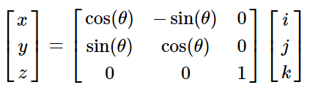
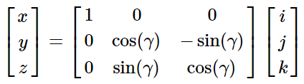
Rotation

Slide 38
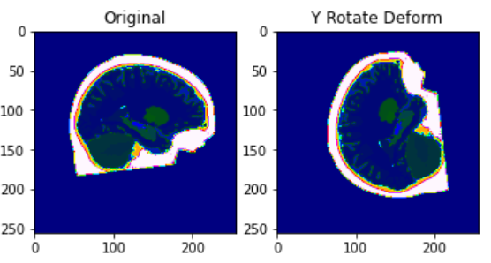
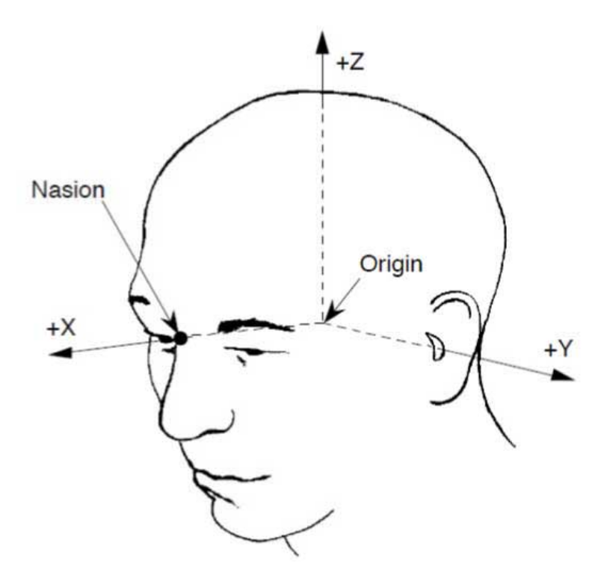
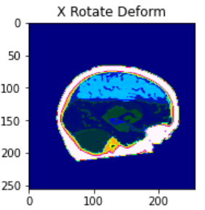
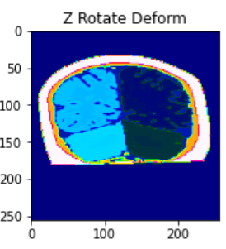
256
256
160
https://www.fieldtriptoolbox.org/faq/coordsys/

Slide 39
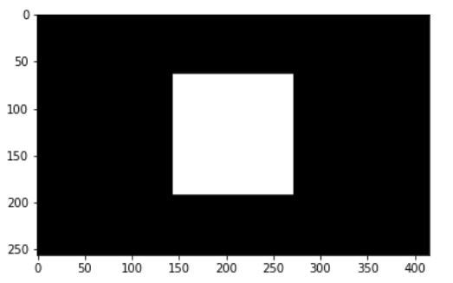
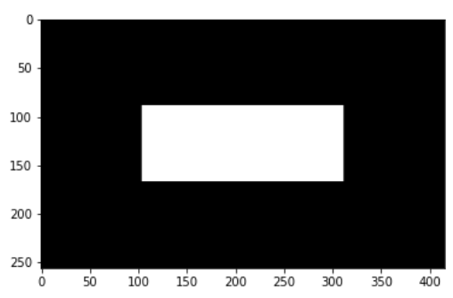
影像非正方形變形問題
逆時針
旋轉90度

Slide 40

解決方法: Padding到三個維度等長(正方體)
Padding前
Padding後

Slide 41
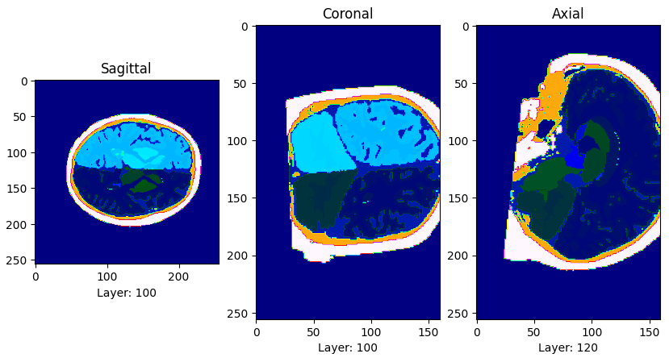
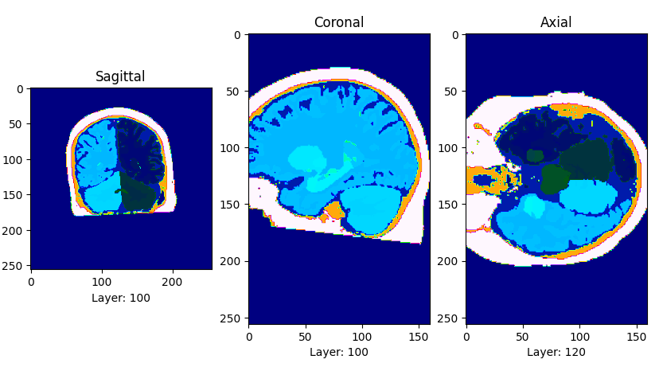

3軸旋轉輸出結果
X軸
Z軸
Y軸

Slide 42



Shear

Slide 43

Combine Transforms

Slide 44



Translation

Slide 45


加入 Translation

Slide 46


Non-linear Deform

Slide 47


Slide 48

Integrate: “Scale-and-Square” Method

Slide 49

看不懂

Slide 50

3D Result

Slide 51


GMM Sampling

Slide 52



Slide 53


Bias field

Slide 54



Slide 55


Intensity augmentation

Slide 56



Slide 57



Simulation of resolution variability

Slide 58


Slide 59


Slide 60
參數值
-0.3 0.3

Slide 61


輸出結果比較

Slide 62


Slide 63
訓練
First layer counts 24 feature maps Unet
Adam optimizer
Learning rate 10⁻⁴
Batch size 1

Slide 64


Model Output
Ground Truth Label

Slide 65



Slide 66

VMware虛擬機安裝Ubuntu20.4 Freesurfer

Slide 67
待解決問題
Non-linear deform: stationary vector field 的 Integrate
用freesurfer產生更多training data
Downsample的Gaussian Blur kernel大小不確定
用Paper給的RandomGammaTrasnform的simga出來的雜訊很大
嘗試其他model, loss

